Slide 1

SECOND REVIEW PROJECT PRESENTATION ON 25TH MARCH 2025
AUTOMATED RESUME BUILDER AND JOB MATCHER
Presented by
Sayan Bhattacharjee (2101321550051)
Abhishek (2201321559001)
Gaurav Jain (2101321550031)
Priyanshu (2201321559006)
Department of CSE-IoT, GNIOT Engg. Institute

Slide 2
CONTENTS
Project Title Justification
Objective
Scope
Literature Review
Analysis and Explaination
Methodology
Screenshots

Slide 3
Project Title Justification
The title reflects the integration of artificial intelligence to automate and enhance the resume screening and job recommendation process. It aims to assist students and job seekers in creating optimized resumes, matching skills with job roles, and preparing for industry-standard ATS systems.

Slide 4
Objective
To recommend suitable jobs based on user’s resume using AI.
To calculate ATS compatibility score.
To generate professional resumes from user input.
To detect missing skills or areas of improvement in a resume.

Slide 5
Scope
Useful for students, freshers, and job seekers.
Automates resume screening and improves job matching.
Supports resume creation for those without templates.
Can be extended to support recruiter-side features.

Slide 6
Literature Review / Uniqueness
Most online tools only match based on job title.
Our system uses TF-IDF and cosine similarity to match on actual skills and content.
Unlike other platforms, we provide:
• ATS Score with missing skills
• Resume Builder
• Error/Improvement Checker
One-stop portal combining multiple features.

Slide 7
Analysis and Explanation
Resume text is extracted using PyPDF2 for PDF resumes.
Job data (title and skills) is fetched from MySQL database.
The text content is cleaned and preprocessed:
• Lowercased, punctuation removed, stopwords filtered.
TF-IDF is applied to convert text into vector space.

Slide 8
Analysis and Explanation
Cosine similarity measures how close resume vector is to job skill vectors.
Top 5 job roles are recommended based on similarity score.
ATS score is calculated using keyword match from job description.
Missing skills are identified and shown for resume improvement.

Slide 9
Methodology
User uploads resume or enters data via form (Resume Builder).
Resume content is extracted or constructed.
Skills from resume are preprocessed and tokenized.
Job listings are fetched from the database.
Each job's skills are vectorized using TF-IDF.

Slide 10
Methodology
Cosine similarity score is calculated between resume and jobs.
ATS score is computed using job description keywords.
Resume Checker analyzes missing or underused skills.
Resume Builder outputs .docx resume file ready to download.
Flask handles all user interactions and results display.

Slide 11
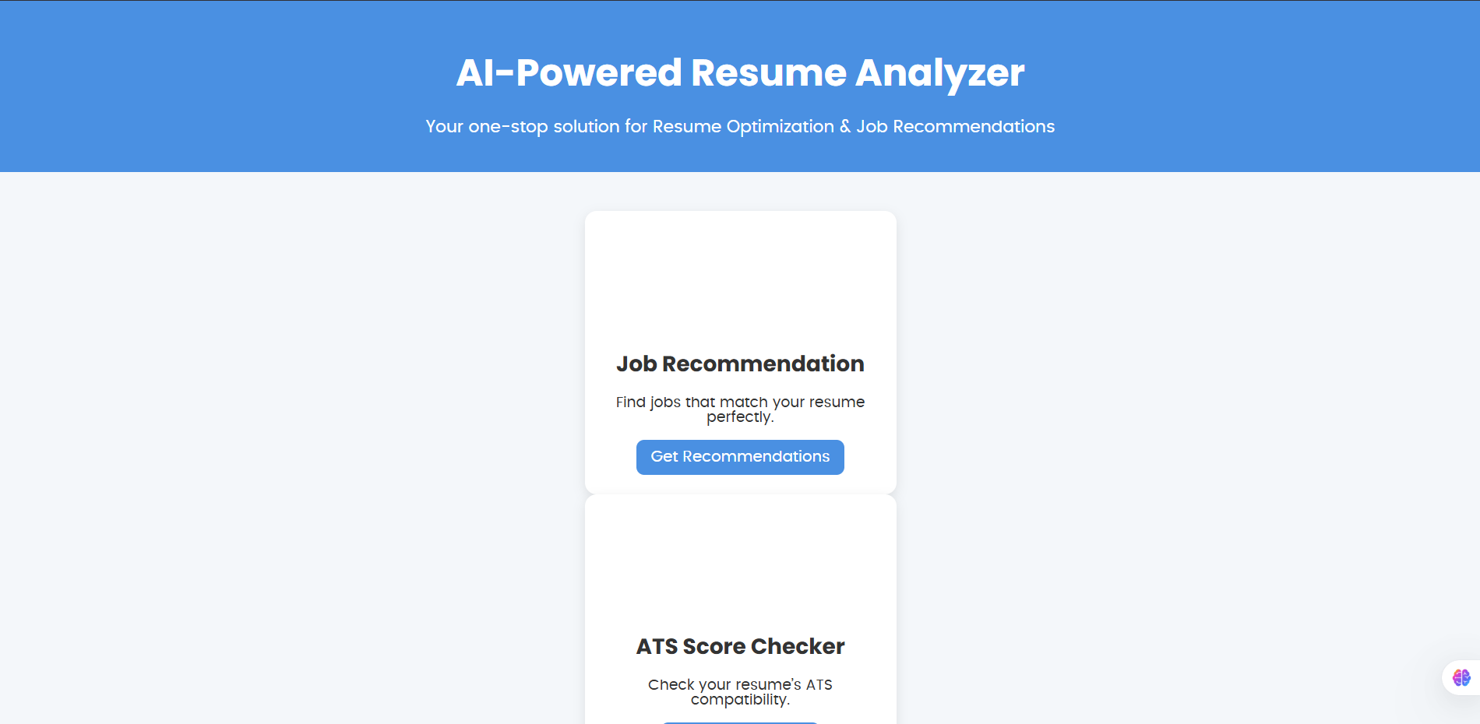
SCREENSHOTS

Slide 12
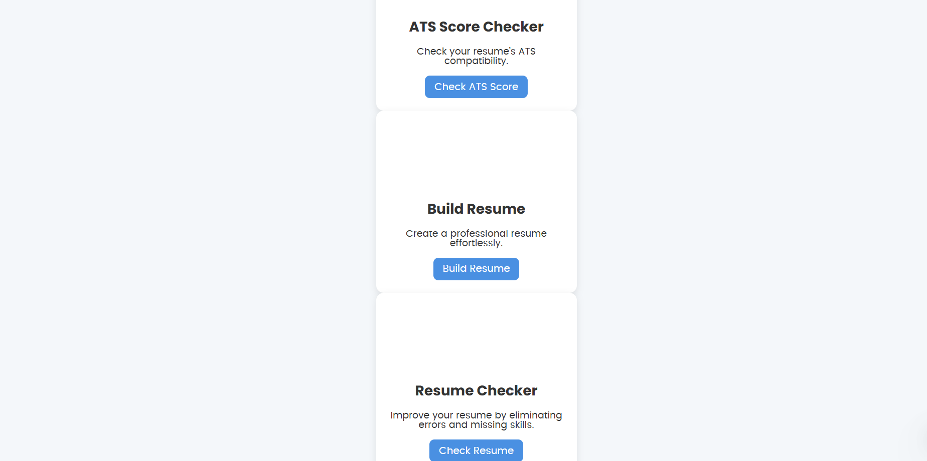
SCREENSHOTS

Slide 13
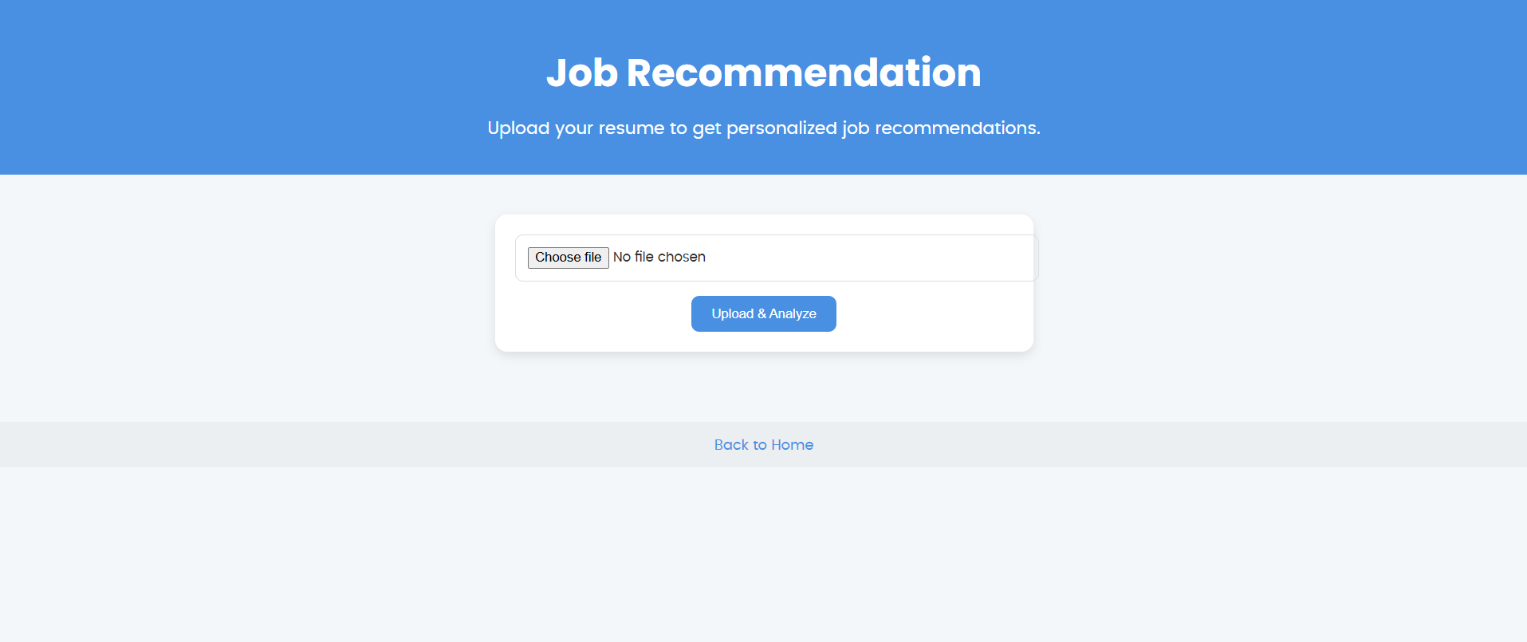
SCREENSHOTS

Slide 14
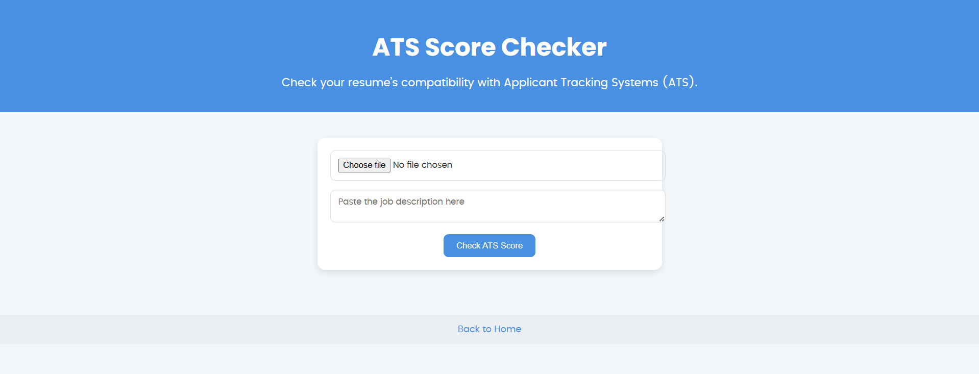
SCREENSHOTS

Slide 15
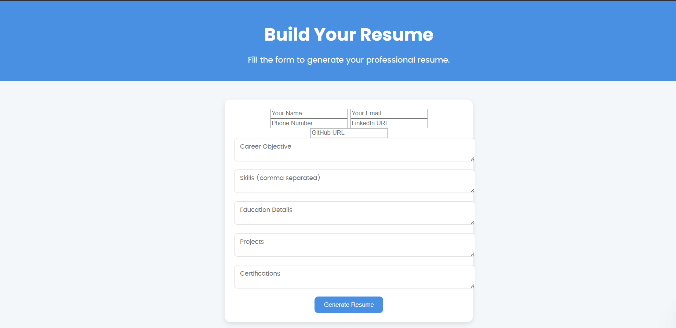
SCREENSHOTS

Slide 16
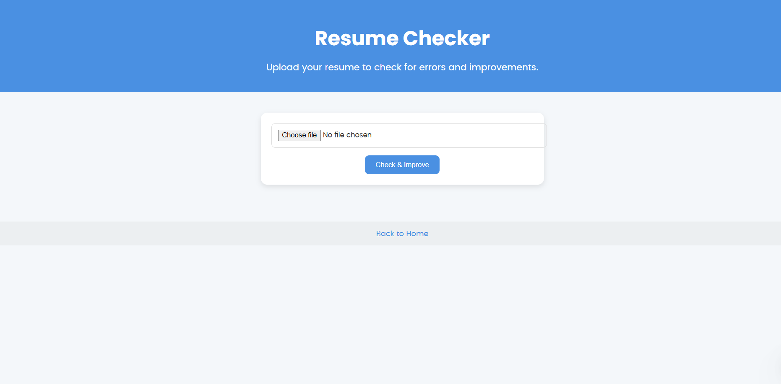
SCREENSHOTS

Slide 17
THANK YOU

